Slide 1

Optimizing Agricultural Resource Allocation through Reinforcement Learning for Yield Improvement
A Cost-Driven Approach to Crop Efficiency Enhancement in Pakistan
Final Thesis Defence Presentation
Haider Masood (401636)
MS Artificial Intelligence
Supervisor: Dr. Zuhair Zafar
Department of Computing, NUST SEECS | March 2026
1

Slide 2
Presentation Outline
OUTLINE
Introduction, motivation, and Pakistan context
Research gap, problem statement, and thesis scope
Methodology and system architecture
Implementation evidence and verification logs
Latest broad NPK matrix and current status
Historical benchmark context and runtime profile
Contributions, limitations, and future work
Conclusion
Haider Masood | MS-AI Thesis Defence | March 2026
2

Slide 3
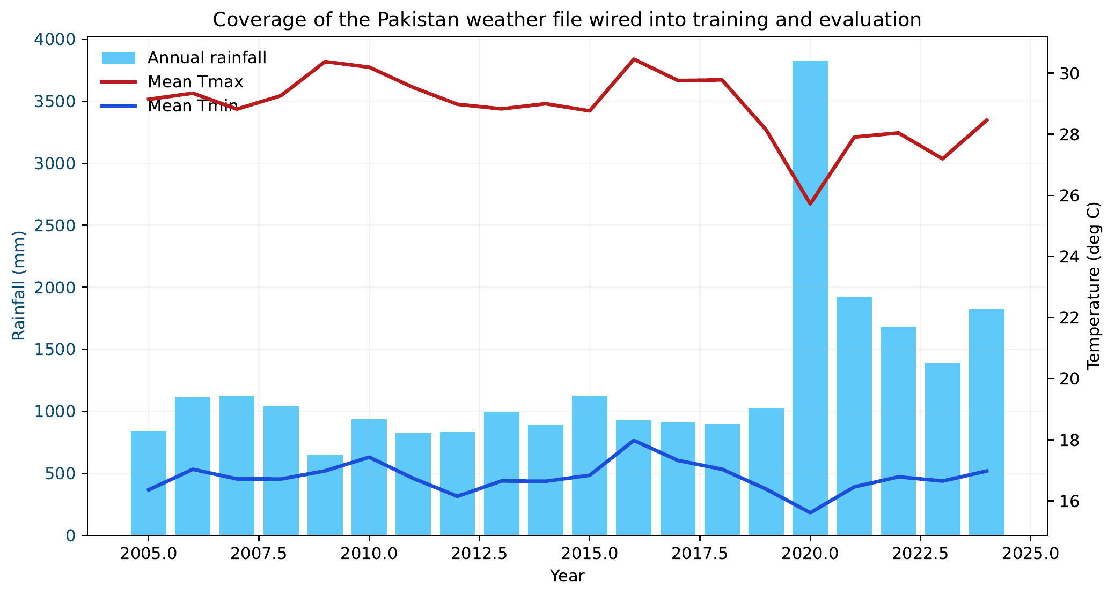
Introduction and Motivation
CONTEXT
Pakistan agriculture is economically critical and operationally risk-sensitive.
Field trial-and-error is expensive when weather and fertilizer costs are volatile.
Simulation-first RL narrows viable policy space before field-adjacent validation.
Defence claim: this thesis contributes a localized, evidence-disciplined RL stack.
Localized weather/soil/economic inputs are implemented, not just proposed.
Haider Masood | MS-AI Thesis Defence | March 2026
3

Slide 4
Research Gap and Problem Statement
RESEARCH GAP
Most RL agriculture stacks are built for non-Pakistan assumptions.
Legacy setup lacked complete NPK-aware economics and report-level traceability.
Proposal ambitions exceeded current implemented controls in some areas.
Problem Statement
Existing RL agricultural systems designed for North American/European contexts are not directly transferable to Pakistani climate, crop, and economic conditions.
Thesis response: localization + NPK expansion + hierarchical reporting + strict claims policy.
Haider Masood | MS-AI Thesis Defence | March 2026
4

Slide 5
Solution Scope: Implemented vs Deferred
SCOPE
Implemented
Deferred / Future
Pakistan weather and soil integration
Year-varying Pakistan crop and nutrient price series
NPK-aware fertilization and reward decomposition
Hierarchical planning + weekly fertilization control
Standardized summary JSON and reporting callbacks
Irrigation as learned action
Rice-specific cultivar localization
Rice-wheat finalized campaign
Post-thesis rerun expansion beyond frozen 113+42 packs
Haider Masood | MS-AI Thesis Defence | March 2026
5

Slide 6
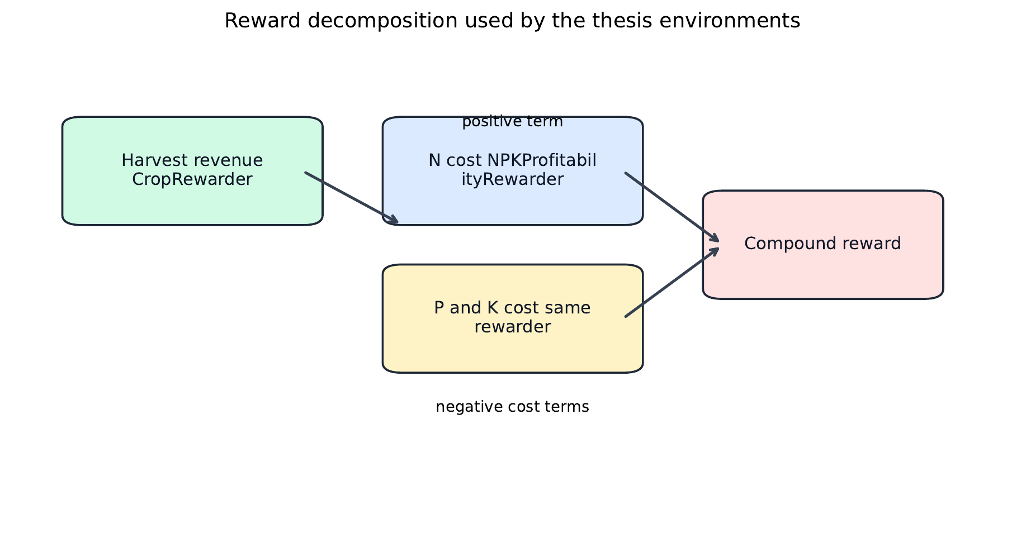
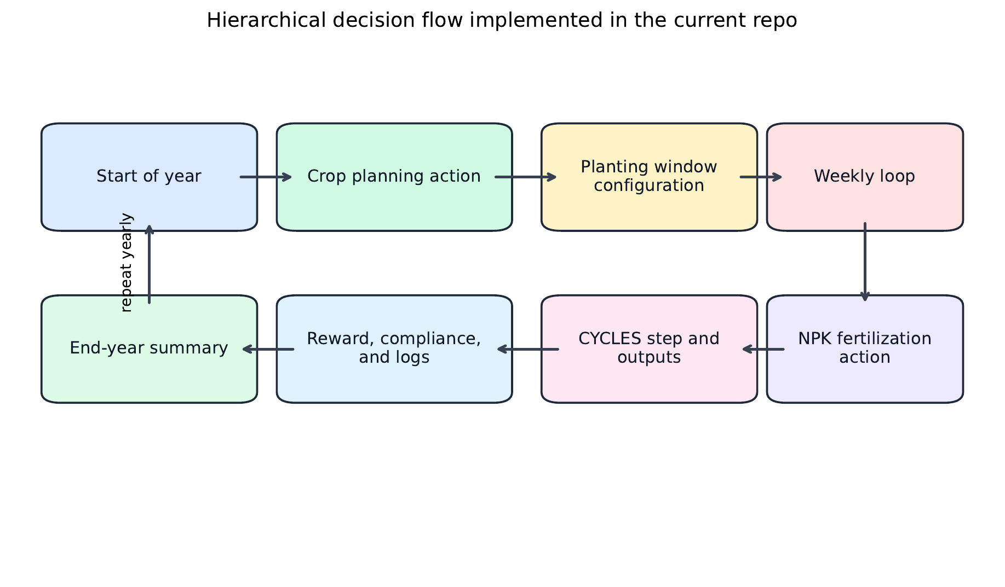
Methodology Overview
METHODOLOGY
Objective: maximize discounted return with explicit NPK cost decomposition
Corn fertilization environment: 7-day decisions, N or NPK action channels.
CropPlanningFixedPlanting: yearly crop + planting week decisions.
Hierarchical environment: yearly planner plus within-season nutrient control.
Reporting design keeps cost channels and compliance metrics interpretable.
Haider Masood | MS-AI Thesis Defence | March 2026
6

Slide 7
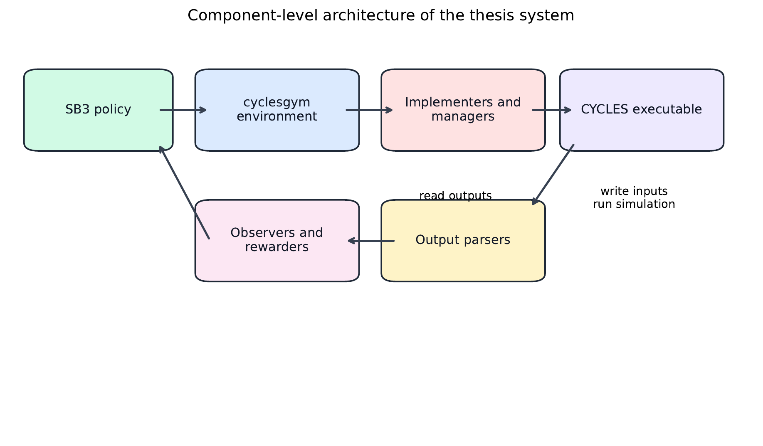
Current Thesis System Architecture
IMPLEMENTATION
Policy layer: PPO/A2C/DQN
Environment layer: Corn, planning, hierarchical variants
Simulation I/O: CYCLES inputs, execution, outputs
Reporting layer: per-step info + per-run summary JSON
Haider Masood | MS-AI Thesis Defence | March 2026
7

Slide 8
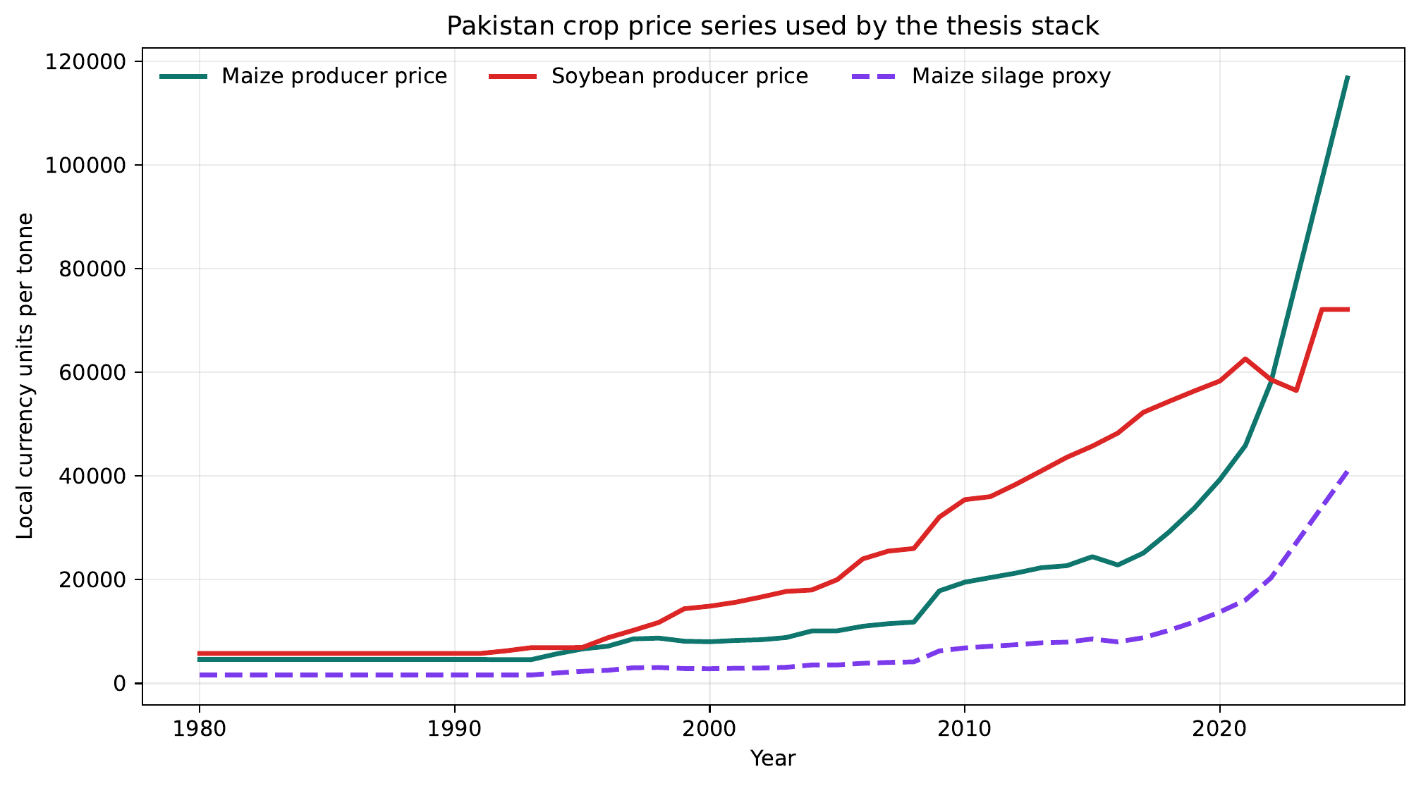
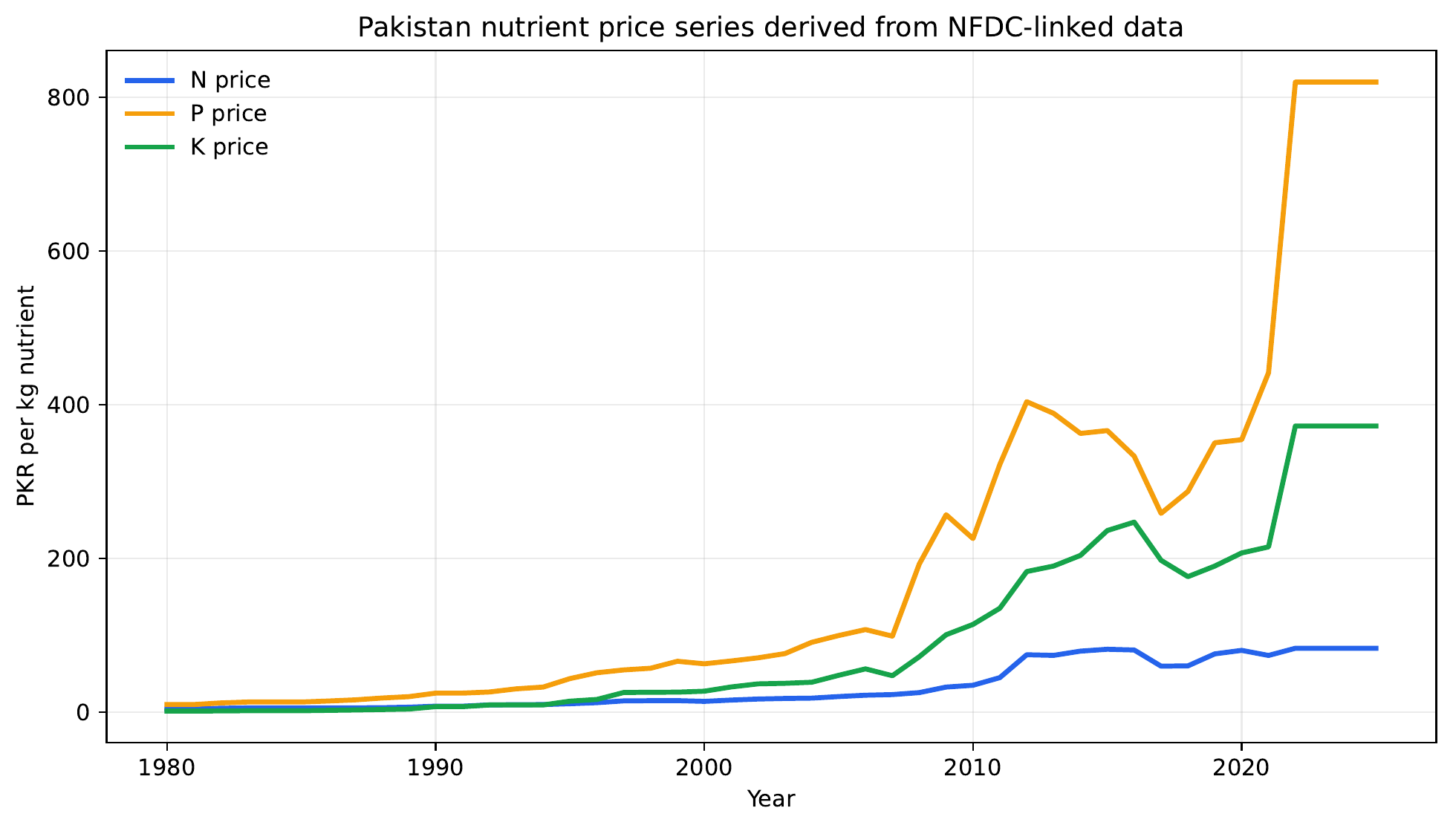
Localized Economic Inputs
DATA
Both series are consumed by Pakistan yearly price profiles used in reward calculations.
Haider Masood | MS-AI Thesis Defence | March 2026
8

Slide 9
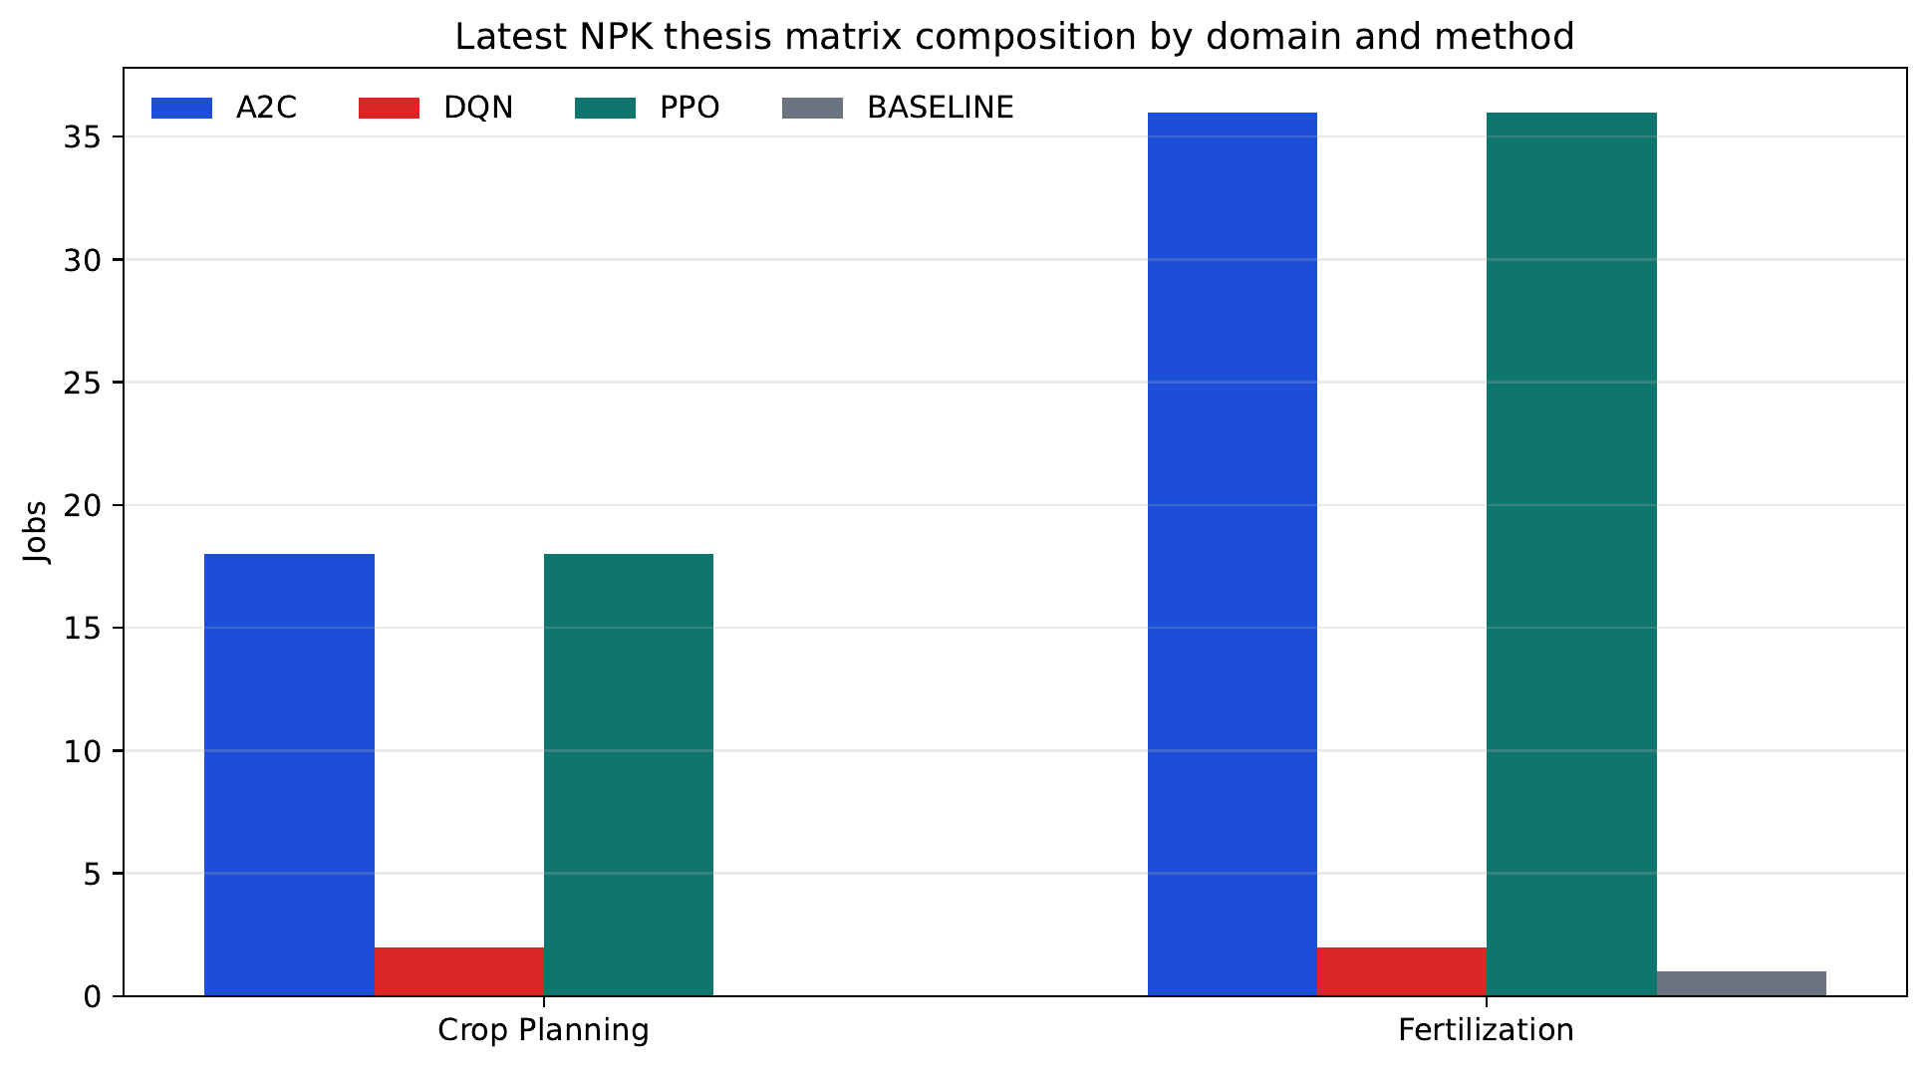
Latest Broad NPK Experiment Matrix
EVALUATION PLAN
Runner: run_experiments_7_3_2026.py
Total jobs encoded: 113
Fertilization jobs: 75
Crop-planning jobs: 38
Main method: PPO, with A2C baseline and DQN ablation
Haider Masood | MS-AI Thesis Defence | March 2026
9

Slide 10
Verification Logs and Smoke-Run Evidence
VALIDATION
Verification commands (8 March 2026)
Smoke Run
test_thesis_reporting: Passed
test_pricing_utils: Passed
test_crop_planning: Passed
test_hierarchical_env: Passed
build.ps1 thesis rebuild: Passed
Run: offline_20260308_071804
Domain: fertilization | Method: PPO
Mode: NPK, fixed weather, 1000 years
Deterministic: 1819.76
Stochastic mean: 1805.40
Std: 17.60
Pakistan holdout: 1816.86
Haider Masood | MS-AI Thesis Defence | March 2026
10

Slide 11
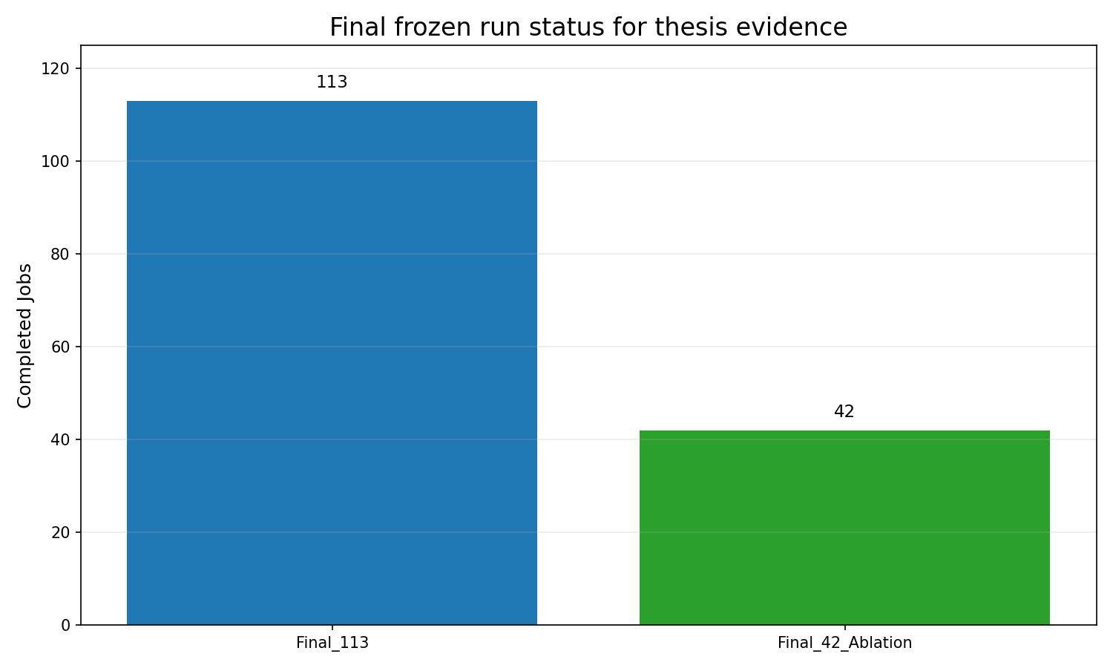
Final Results Status (Frozen Completed Packs)
RESULTS STATUS
Status table
Final matrix rows (final_113): 113
Completed final_113 jobs: 113
Completed final_42_ablation jobs: 42
Frozen reporting packs generated
Final comparative chapter uses these completed packs
Haider Masood | MS-AI Thesis Defence | March 2026
11

Slide 12
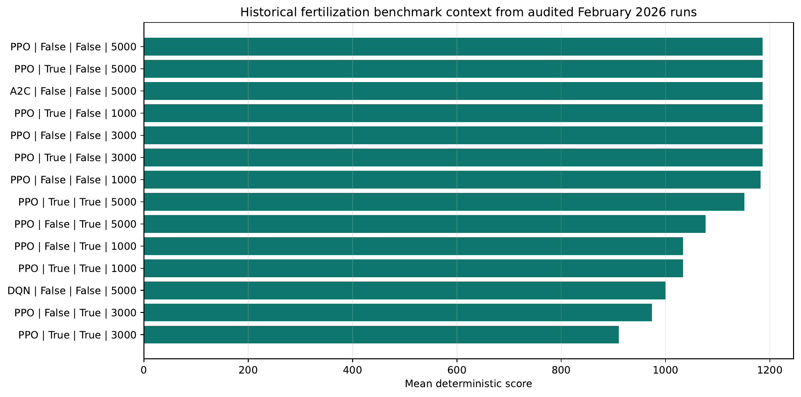
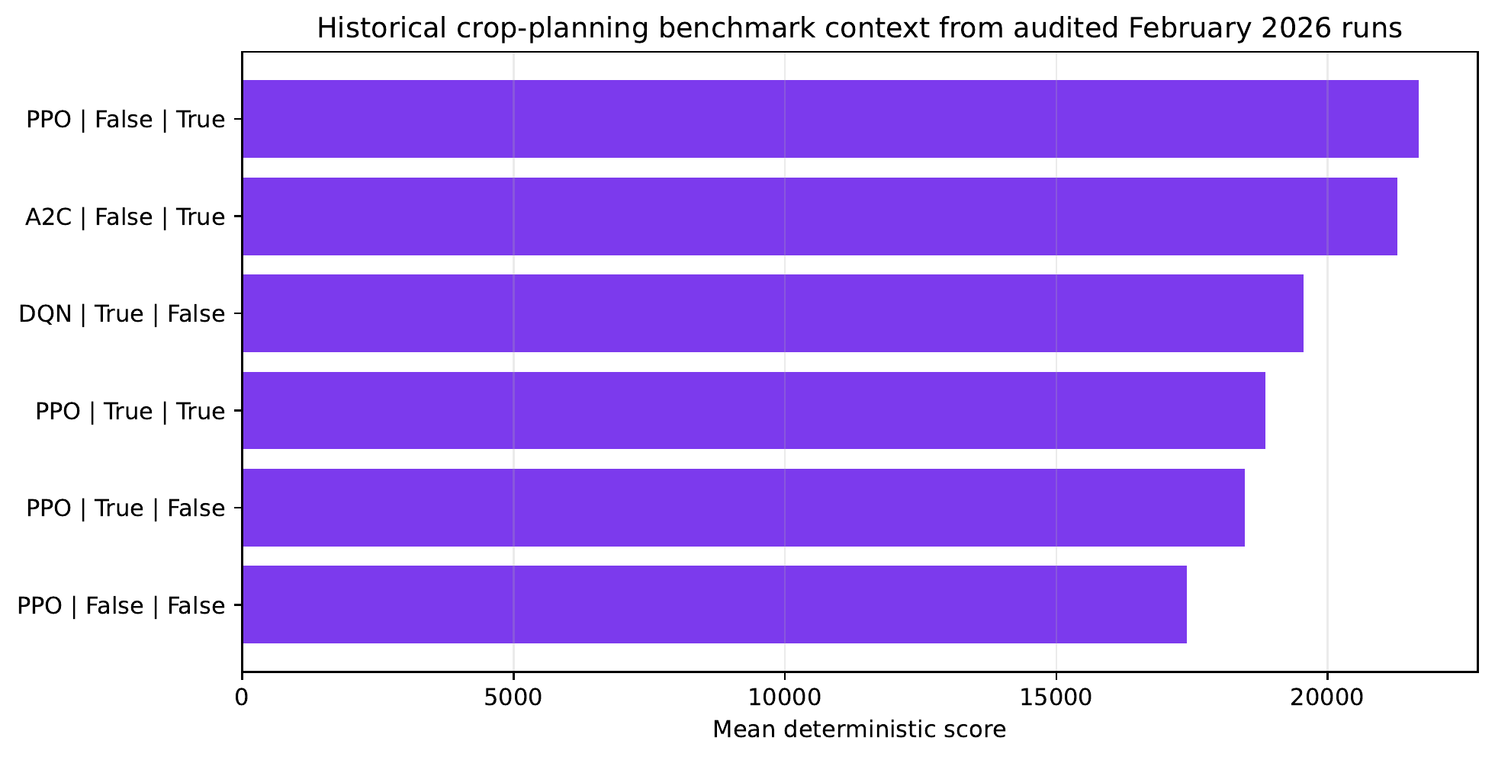
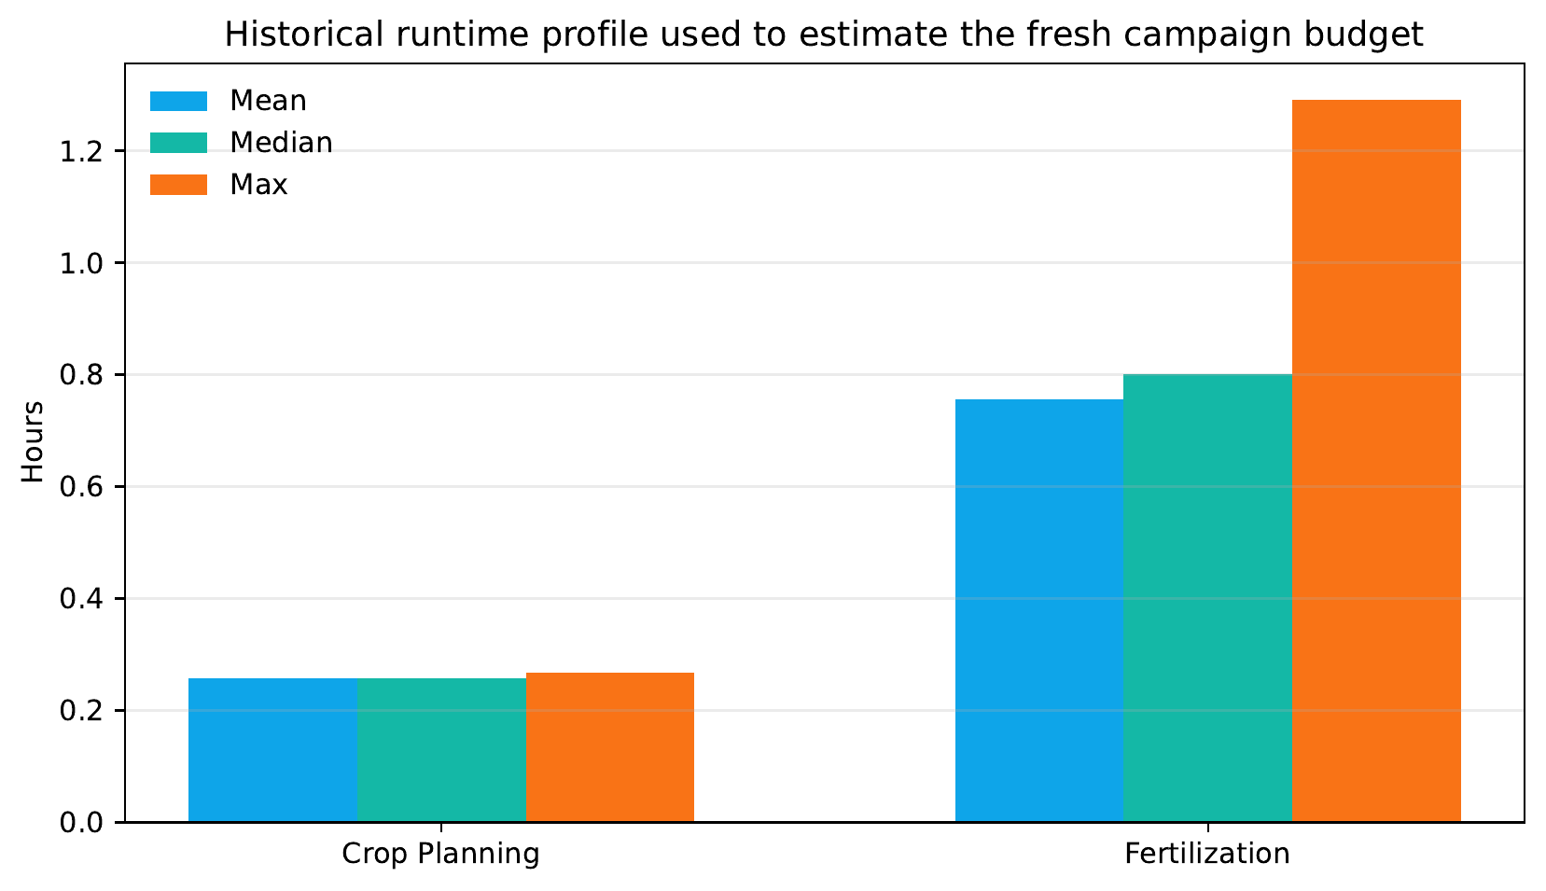
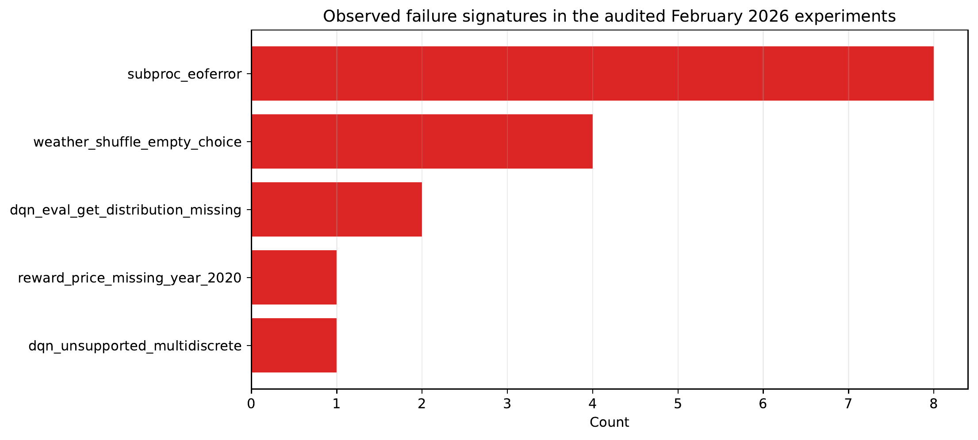
Historical Benchmark Context (Not Final Evidence)
HISTORICAL CONTEXT
Haider Masood | MS-AI Thesis Defence | March 2026
12

Slide 13
Thesis Contributions
CONTRIBUTIONS
Pakistan-adapted localization of weather, soil, and pricing inputs
Shift from mostly N-centric to NPK-capable action/reward/reporting
Hierarchical integration of yearly planning with weekly fertilization
Standardized summary outputs for reproducible thesis evidence
Explicit claims policy separating implemented, partial, and future work
Synopsis closure snapshot
Implemented: 4
Partial: 2
Future: 3
Haider Masood | MS-AI Thesis Defence | March 2026
13

Slide 14
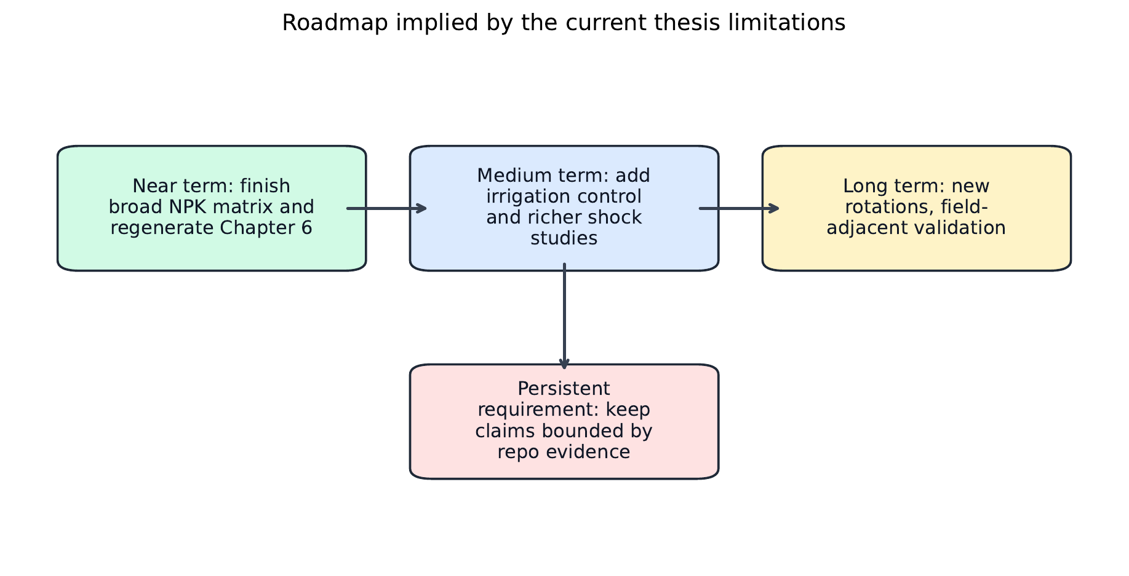
Limitations and Future Work
DISCUSSION
Field validation is not completed; evidence remains simulation-based.
Working crop setup remains maize-soy.
Irrigation is not yet a learned control variable.
External validity remains simulation-based.
Economics is cost-aware but still simplified.
Haider Masood | MS-AI Thesis Defence | March 2026
14

Slide 15
Conclusion
CLOSING
Final Takeaways
Thesis stack is materially improved and localized for Pakistan context.
Engineering contributions are implemented and verification-backed.
Empirical integrity is preserved by mapping claims to frozen 113 + 42 evidence packs.
Next step: post-thesis extensions (irrigation, rice-focused studies, field-adjacent validation).
Thank you
Questions and discussion
Haider Masood | MS-AI Thesis Defence | March 2026
15

